Slide 1
Input and Output in Java Lecture - 7

Slide 2
Contents
Standard Streams
Scanner Class
Types of Streams
Byte Stream vs Character Stream
Command Line arguments

Slide 3
Standard Streams
System.in –read from KeyBoard
System.out-display data on console
System.err-display error messages
import java.lang.*;
java.lang

Slide 4
System.out
System.out is a PrintStream to which you can write characters.
It outputs the data you write to the console.
System.out.print()
System.out.println()
System.out.printf ()

Slide 5
System.in
System.in is an InputStream which is connected to keyboard
Java application read input through keyboard using System.in
Scanner class
BufferedReader class

Slide 6
Scanner Class
We can read java input from System.in using Scanner class
It is available in the java.util package.

Slide 7
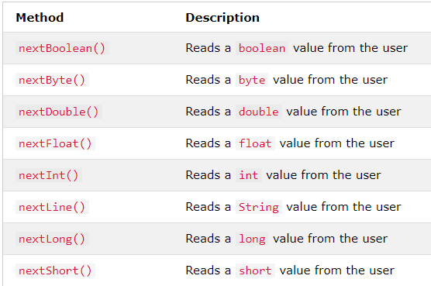
Input Types in Scanner Class

Slide 8
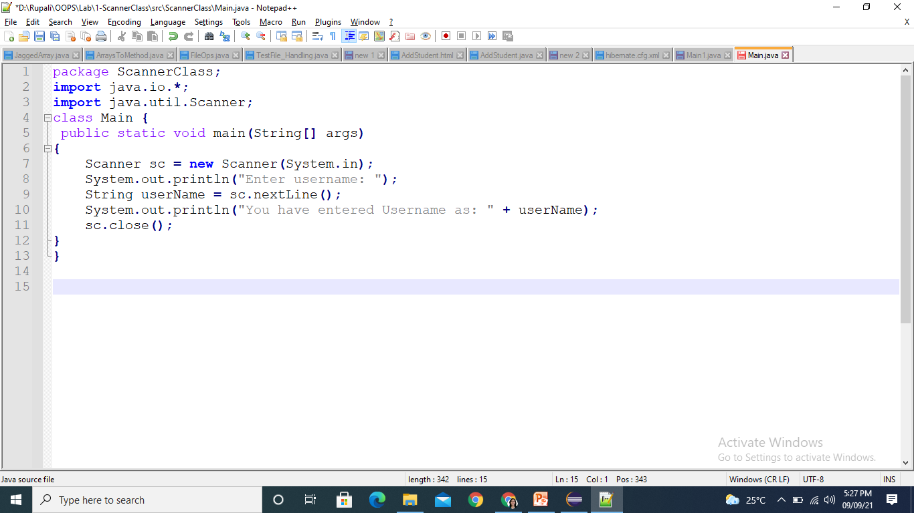
Example using Scanner Class
Program to accept name as an input from User and display onto console.

Slide 9
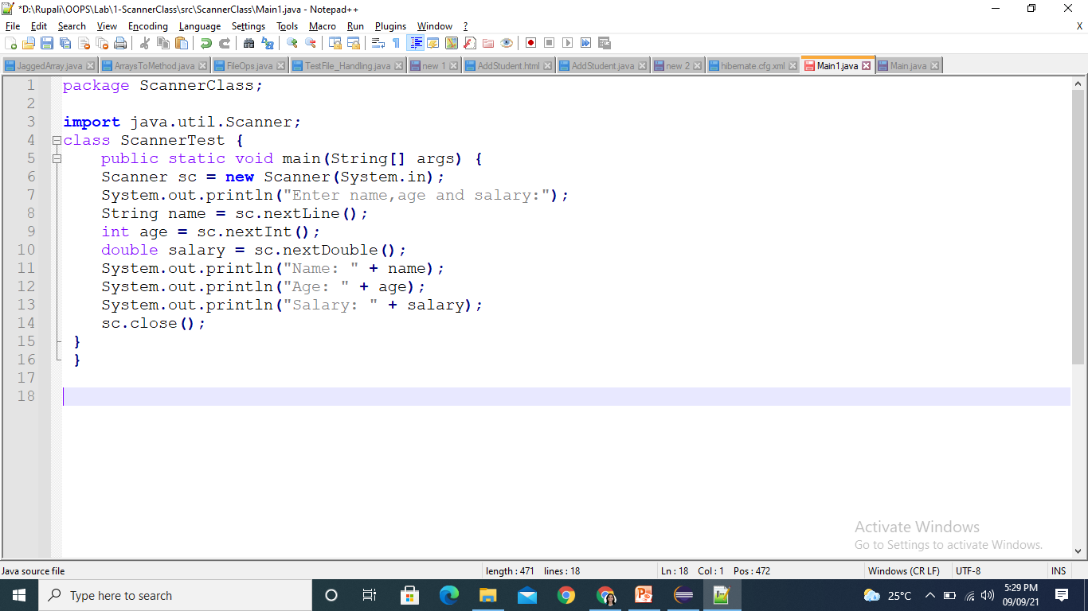
Example using Scanner Class
Program to accept name ,age and salary as an input from User and display onto console.

Slide 10
Types of Streams
What is Stream:
continuous flow of data/sequence of data.
OR
Stream is a logical connection between a java application and source-destination, through which we read data from a source and can store data into a destination .

Slide 11
Types of Streams contd..
Modern version of Java define two types of streams: byte and character
Byte Stream: Provide convenient means for handling input and output of bytes
Character Stream: Designed for handling input and output of characters

Slide 12
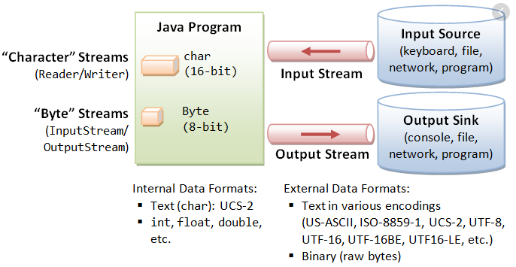
Types of Streams contd..

Slide 13
Byte Stream vs Character Stream
Byte Stream | Char Stream
Reads data byte by byte | Read data character by character
Used for inputting and outputting the bytes | Used for inputting and outputting the char
Two classes :InputStream and OutputStream | Two classes :Reader and Writer

Slide 14


IO Hierarchy
Stream
Byte Stream
Char Stream
InputStream
OutputStream
Reader
Writer
Read ()
Write ()

Slide 15
Command Line arguments
It is an argument passed at the time of running the java application.
The arguments passed from the console can be received in the java program and it can be used as an input.
A Java application can accept any number of arguments from the command line.
The user enters command-line arguments when invoking the application and specifies them after the name of the class to be run.
For example, suppose a Java application called Sort sorts lines in a file. To sort the data in a file named friends.txt, a user would enter: java Sort friends.txt

Slide 16
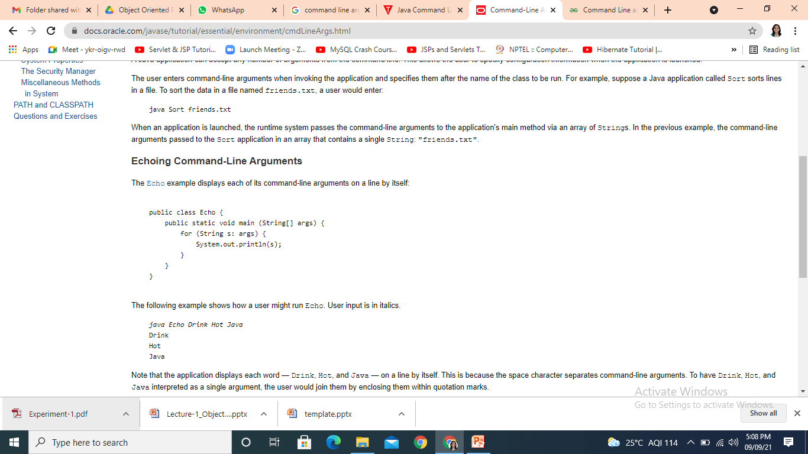
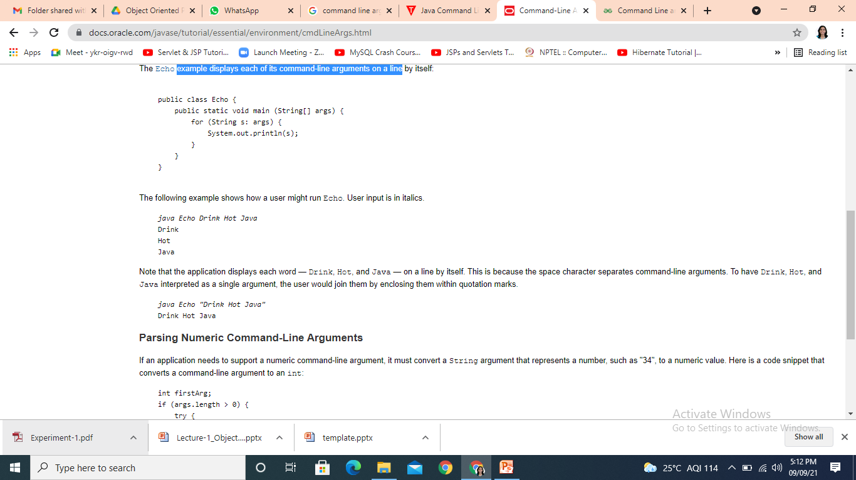
Command Line arguments contd..
When an application is launched, the runtime system passes the command-line arguments to the application's main method via an array of Strings.
Example:
Output

Slide 17
Contents
Scanner vs BufferedReader Class
Formatted output
Reading input from console

Slide 18
IO Hierarchy
Stream
Byte Stream
Char Stream
InputStream
OutputStream
Reader
Writer
Read ()
Write ()

Slide 19
IO Hierarchy contd..
Two major hierarchies in Java:
InputStream and OutputStream class hierarchy
This hierarchy enables data input-output in binary mode.
Reader and Writer class hierarchy
This hierarchy enables data input-output in text mode.

Slide 20
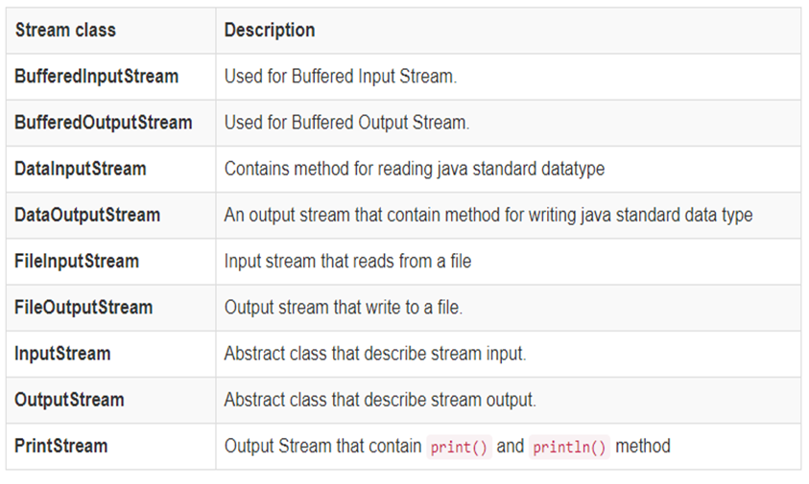
Input and output stream subclasses

Slide 21
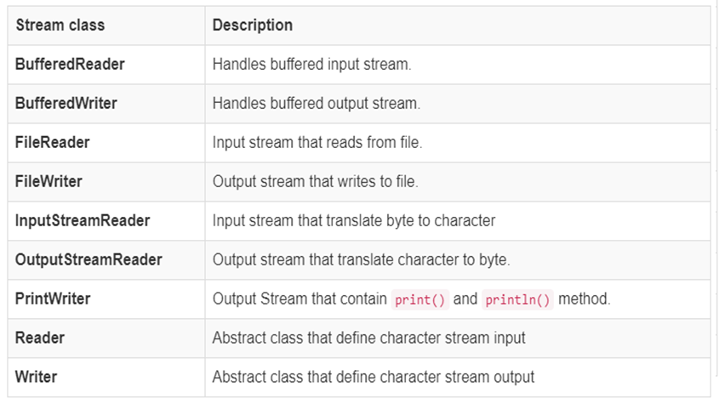
Reader and Writer subclasses

Slide 22
BufferedReader
This class provides a method :
int read() and String readLine()
Read text from a character-input stream ,buffering characters so as to provide fast and efficient reading of characters.
The BufferedReader reads characters from stream without causing device access every time.
Significant performance improvement
Read() operations are reduced

Slide 23

BufferedReader contd..
1010110010
1010110010
1010110010
1010110010
DeviceBuffer
System.in
InputStream Reader
Buffered Reader
KB
Java Application

Slide 24
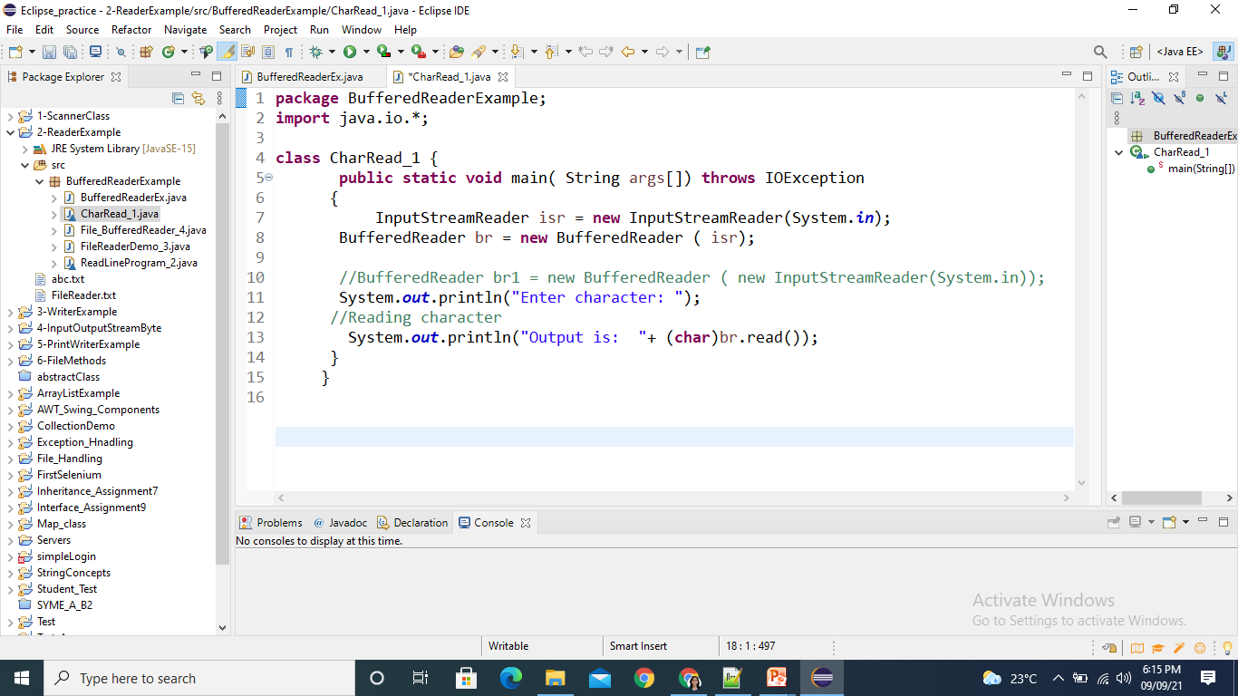
Example using BufferedReader
Program to read a character using read() method of BufferedReader class

Slide 25
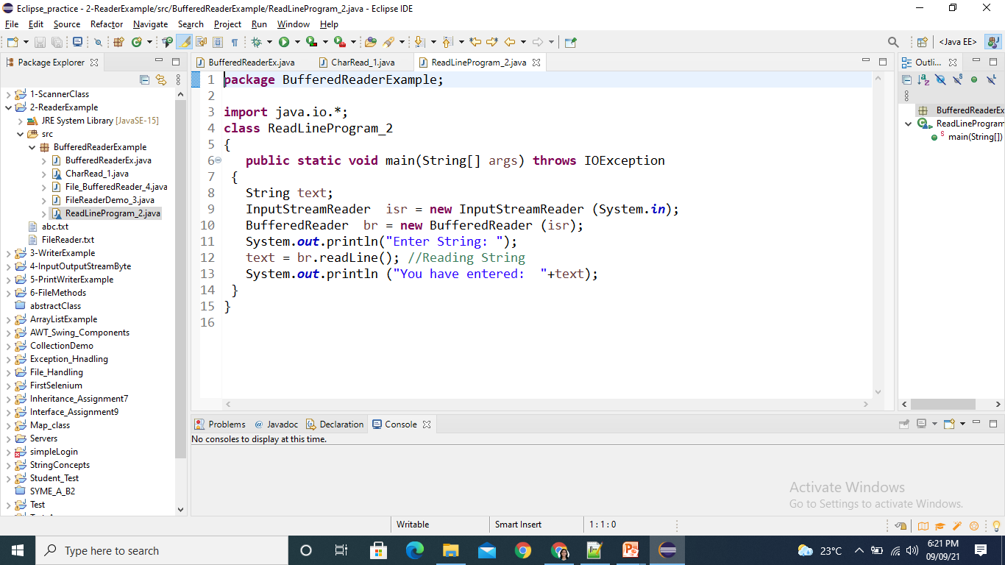
Example using BufferedReader
Program to take String input from Keyboard using readLine() method of BufferedReader class.

Slide 26
Scanner vs BufferedReader Class
Scanner class is a simple text scanner which can parse primitive types and strings.
BufferedReader class reads text from a character-input stream.
It buffers the characters so as to provide the efficient reading of sequence of characters.

Slide 27
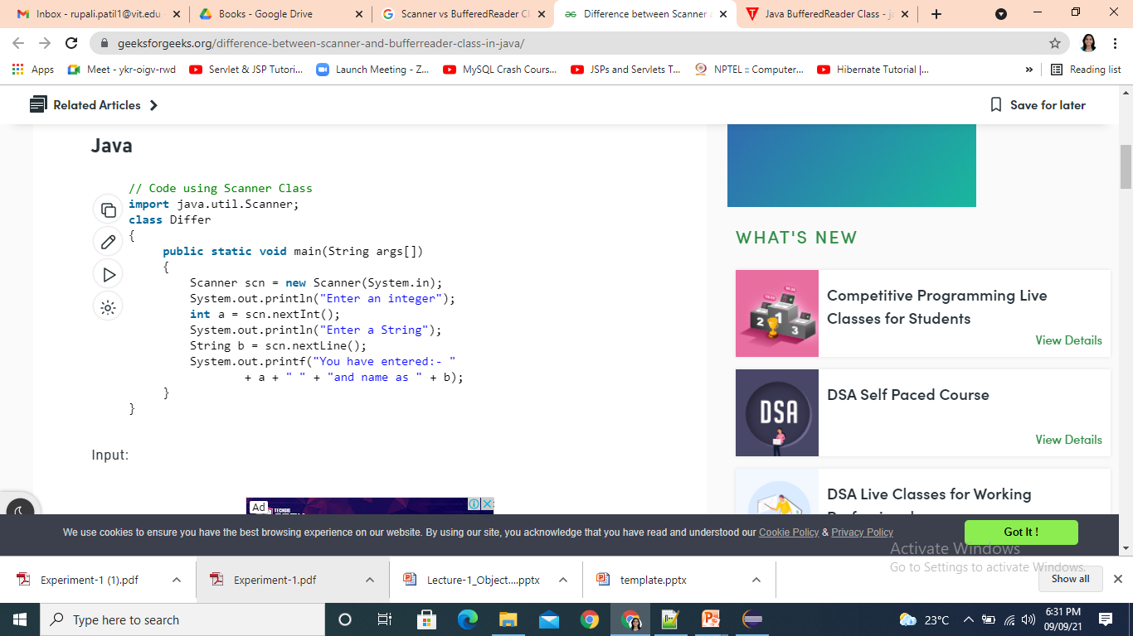
Scanner vs BufferedReader Class

Slide 28
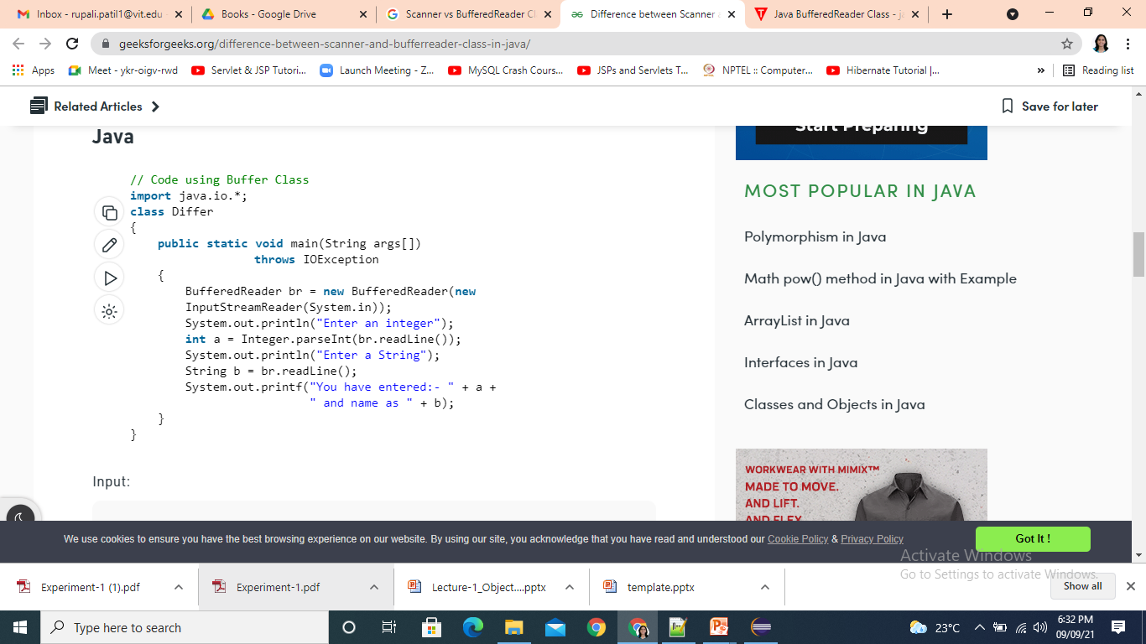
Scanner vs BufferedReader Class

Slide 29
Scanner vs BufferedReader Class
BufferedReader is synchronous while Scanner is not. BufferedReader should be used if we are working with multiple threads.
BufferedReader has significantly larger buffer memory than Scanner.
The Scanner has a little buffer (1KB char buffer) as opposed to the BufferedReader (8KB byte buffer).
BufferedReader is a bit faster as compared to scanner because scanner does parsing of input data and BufferedReader simply reads sequence of characters.

Slide 30
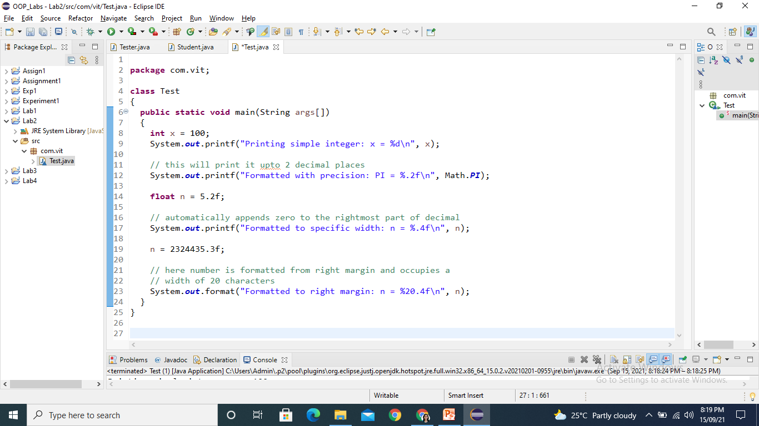
Formatted output
Formatting output using System.out.printf() and format()

Slide 31
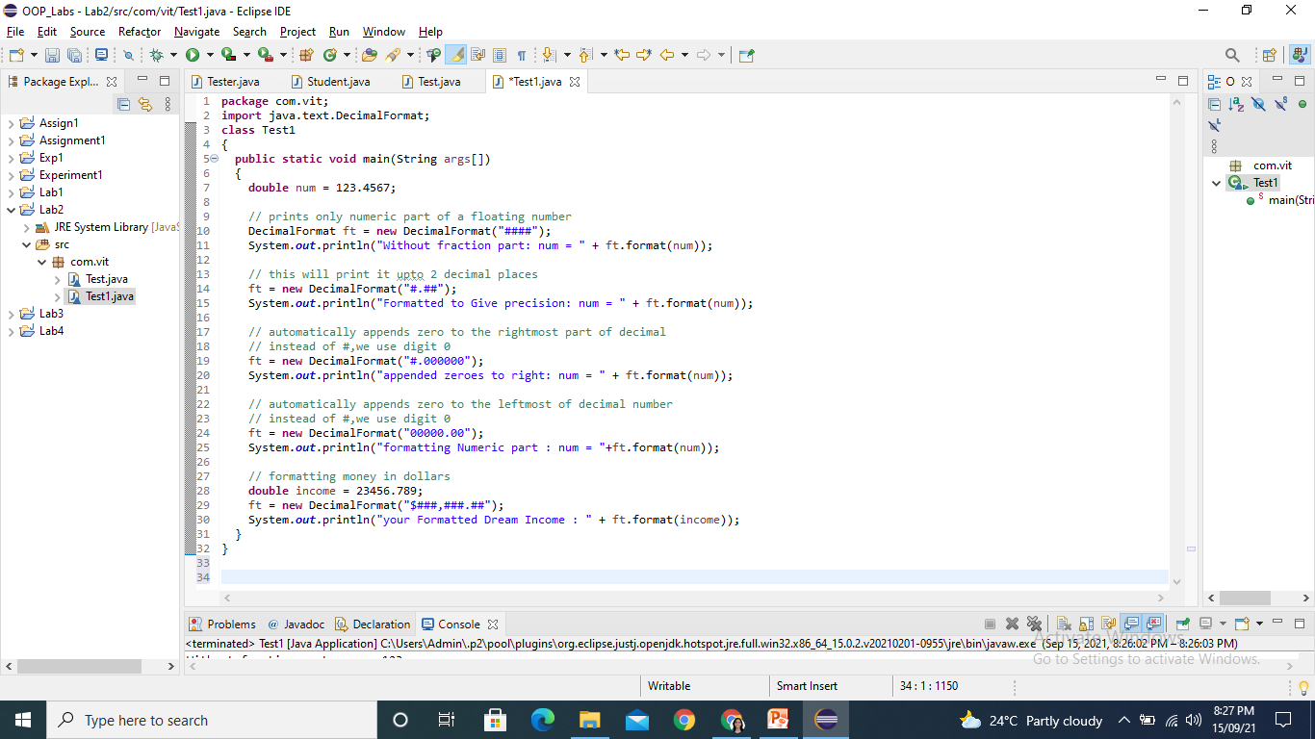
Formatted output
Formatting output using DecimalFormat Class:

Slide 32
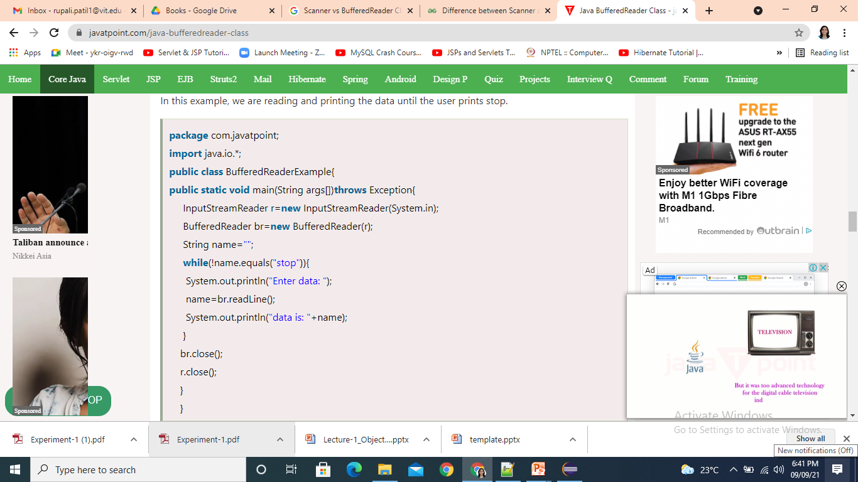
Reading input from console
For reading input from the console one can use scanner class as well as BufferefReader class.
Example: Reading data from console until user writes stop.

Slide 33
Thank You

